Slide 1

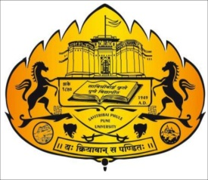
" An Integrated Multimodal Approach for Thyroid Disease Detection Using Imaging and Clinical Data”
Project Review – II Presentation
on
Presented By: Guided By:
1. Pratik Pawar Dr. Amruta Chitari 2. Shreyas Nighot
3. Tejas Dambare

Slide 2
Table of Contents
Introduction
Motivation
Problem Statement
Objectives
Feasibility and Future Scope
Requirement Analysis(H/W and S/W with costing)
Methodology
Datasets
Results
Implementation
Conclusion
References

Slide 3
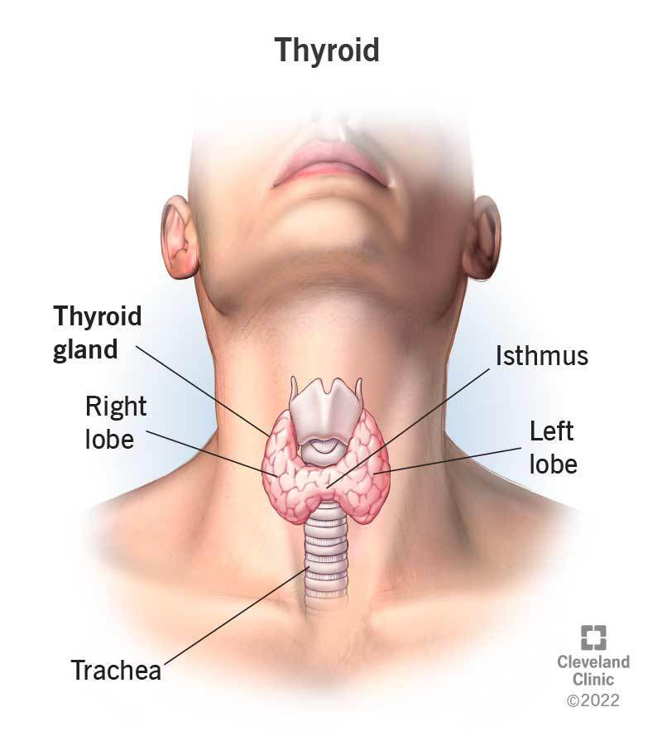
1. Introduction
What is the Thyroid? It is a crucial endocrine gland.
Core Function: It is essential for controlling three key areas of the body:
Growth
Metabolism
Hormone balance in general
Control Hormones: The gland's function is typically measured by key hormones found in the blood:
Thyroid Stimulating Hormone (TSH)
Triiodothyronine (T3)
Thyroxine (T4)

Slide 4
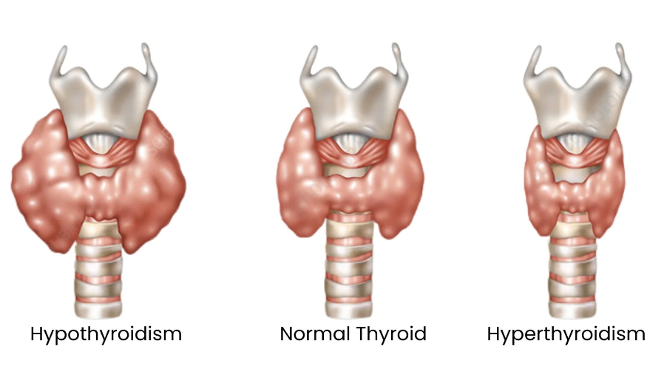
Common Disorders: Thyroid disorders are one of the most prevalent endocrine conditions worldwide.
Two Main Issues: The particularly
common conditions are:
Hypothyroidism (underactive)
Hyperthyroidism (overactive)
Why Diagnosis is Hard :
Imaging Flaw: Ultrasound often relies heavily on the radiologist's skill, which can lead to inconsistency or misinterpretation.
Lab Flaw: Blood tests are accurate for hormone levels, but they may not detect physical issues like anatomical abnormalities.
The Result: Using only one method limits overall accuracy and can cause missed cases or incorrect diagnoses.

Slide 5

2. Motivation
Traditional thyroid diagnosis uses ultrasound images or blood tests separately, which may reduce accuracy. This project combines both data sources to improve thyroid disease detection.

Slide 6
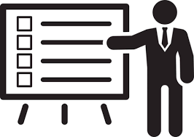
3. Problem Statement
Develop a hybrid deep learning framework using CNN and Random Forest to improve the accuracy and reliability of thyroid disease detection.

Slide 7
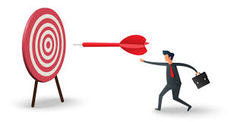
4. Objectives
Develop a multimodal system using ultrasound images and clinical data.
Extract image features using CNN and analyze clinical data using Random Forest.
Integrate both models to improve thyroid disease detection accuracy.
Classify patients as Normal, Hypothyroid, or Hyperthyroid.

Slide 8
5. Feasibility and Future Scope
Feasibility :
Uses readily available ultrasound images and blood test data (TSH, T3, T4).
Employs proven AI models: CNN for images and Random Forest for clinical data.
Achieves high prediction accuracy and reliable results.
Includes Explainable AI features for better trust and interpretation.
Future Scope :
Can be integrated into clinical decision support systems.
Supports accurate and early thyroid disease diagnosis.
Can be extended to diagnose other diseases using multimodal data.
Future enhancements can include advanced Explainable AI and additional patient data.

Slide 9
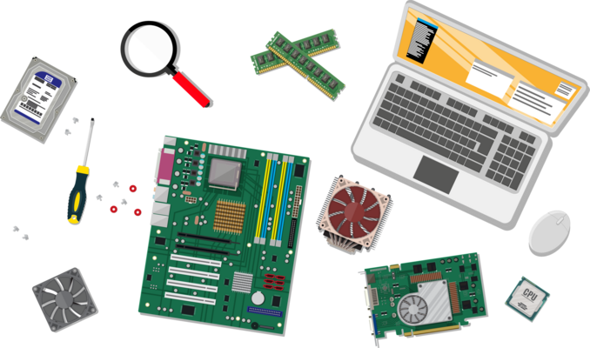
6. Requirement Analysis
Hardware Requirements :
Computer System (Minimum Configuration):
Processor: Intel i5 or higher
RAM: 8 GB or more
Storage: 512 GB SSD
GPU (for Image Processing): NVIDIA GTX 1050 or higher (Optional but recommended)
Estimated Cost: ₹40,000 – ₹60,000

Slide 10
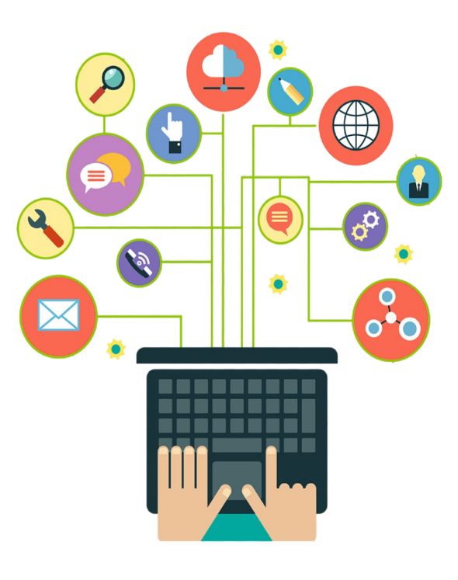
Software Requirements:
Operating System: Windows 10/11 or Ubuntu 20.04+
Programming Language: Python 3.8+
Frameworks:
Deep Learning: TensorFlow or PyTorch (for CNN model development)
Machine Learning: scikit-learn (for Random Forest model)
Libraries:
Image Processing: OpenCV, Pydicom
Data Handling: NumPy, Pandas
Model Interpretation: matplotlib, seaborn, shap (for feature importance)
Development Environment: Jupyter Notebook, VS Code

Slide 11
7. Methodology
Data Collection
Ultrasound Images
Clinical Data (TSH, T3, T4)
Preprocessing
Image preprocessing
Data cleaning & normalization
Feature Extraction
CNN extracts image features
Clinical Data Analysis
Random Forest processes blood test values
Multimodal Fusion
Combine outputs from both models
Classification
Normal
Hypothyroid
Hyperthyroid
Result Generation
Final prediction with explanation

Slide 12
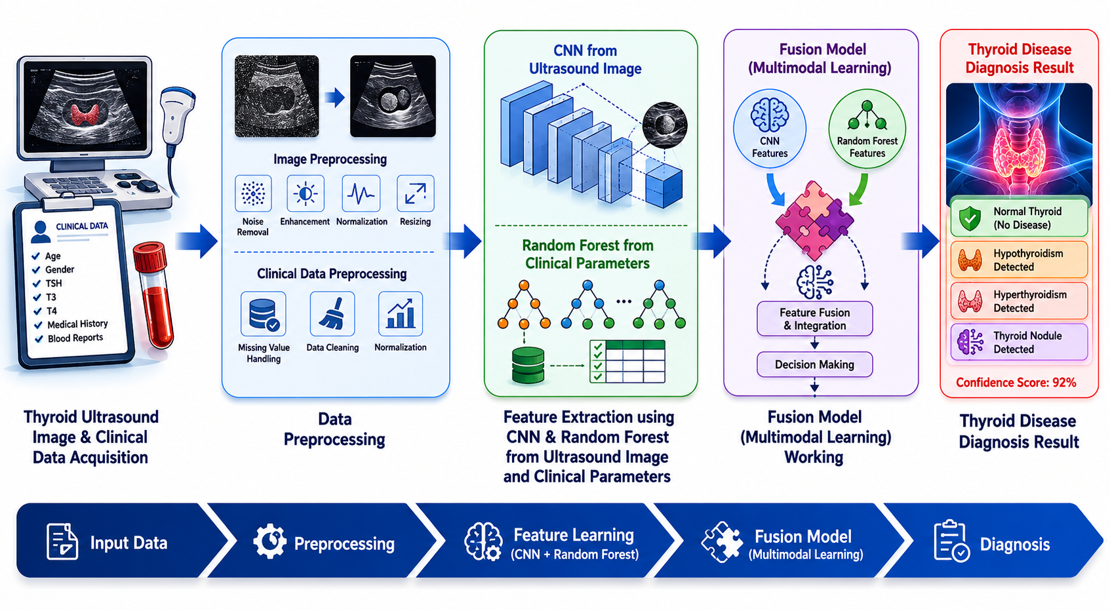

Slide 13
8. Datasets
Dataset 1: Ultrasound Image Dataset
Thyroid ultrasound images
Normal and abnormal thyroid cases
Used for image feature extraction using CNN
Dataset 2: Clinical Dataset
TSH (Thyroid Stimulating Hormone)
T3 (Triiodothyronine)
T4 (Thyroxine)
Age and Gender
Used for classification using Random Forest

Slide 14
9. Results
Achieved 96.1% Accuracy in thyroid disease classification.
Improved prediction reliability using multimodal data fusion.
Successfully classified patients as Normal, Hypothyroid, and Hyperthyroid.
Reduced dependency on manual interpretation of medical data.
Supports early and reliable thyroid disease diagnosis.

Slide 15
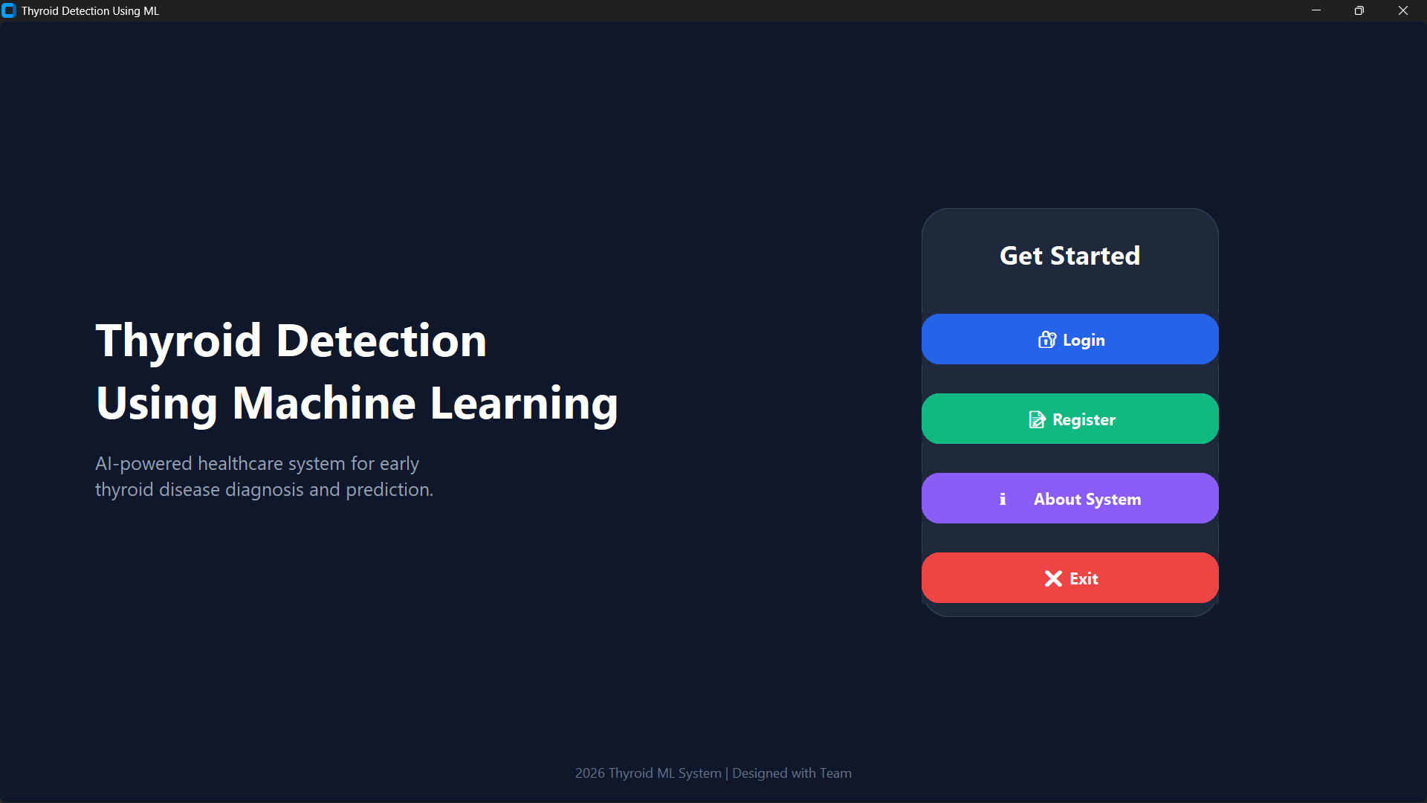
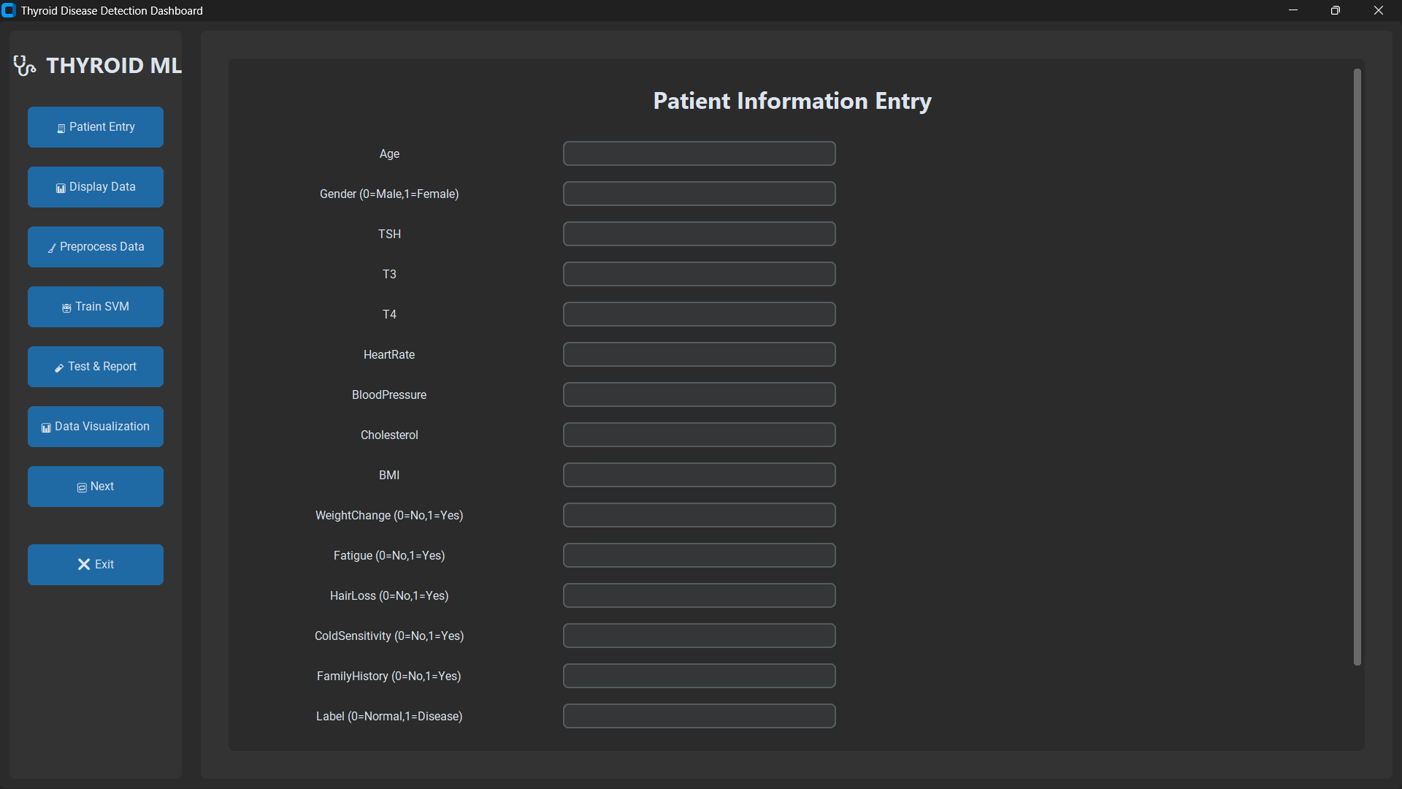
10. Implementation

Slide 16
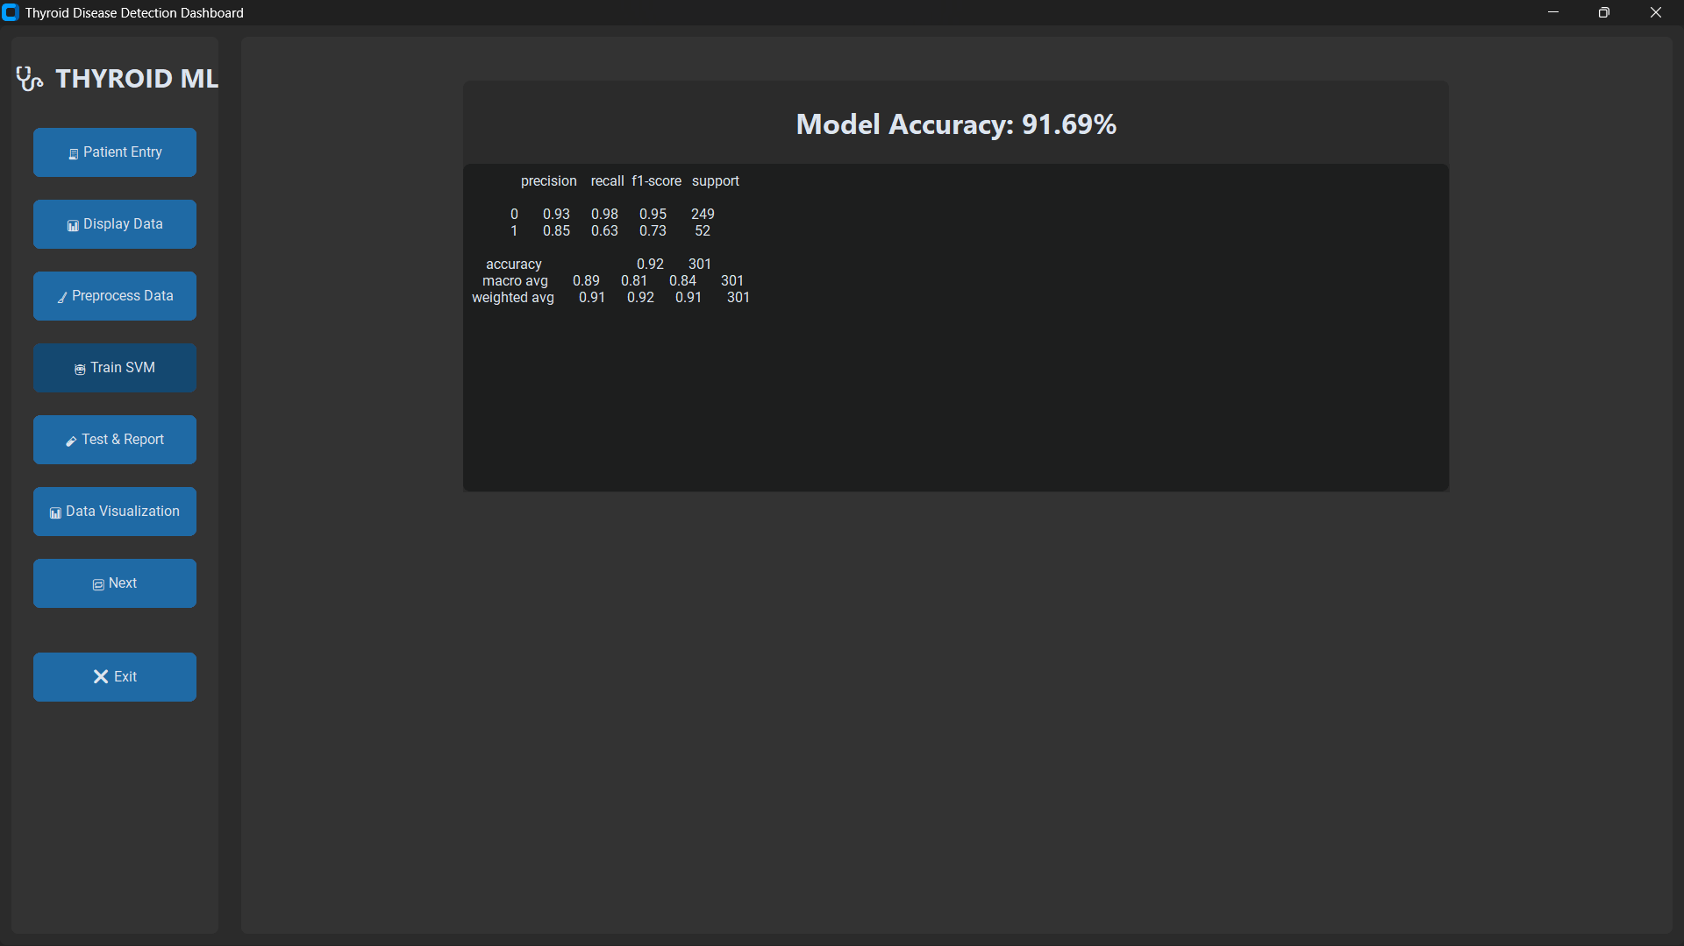
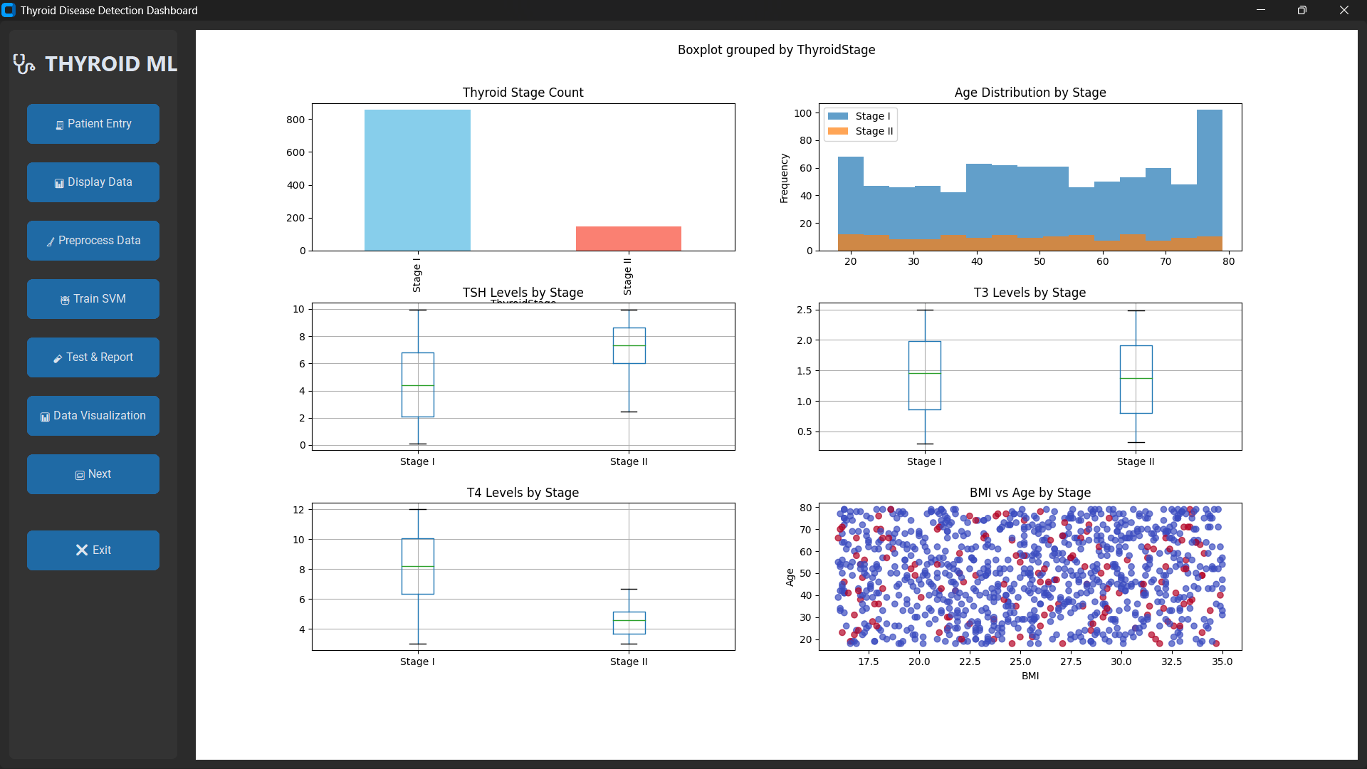

Slide 17
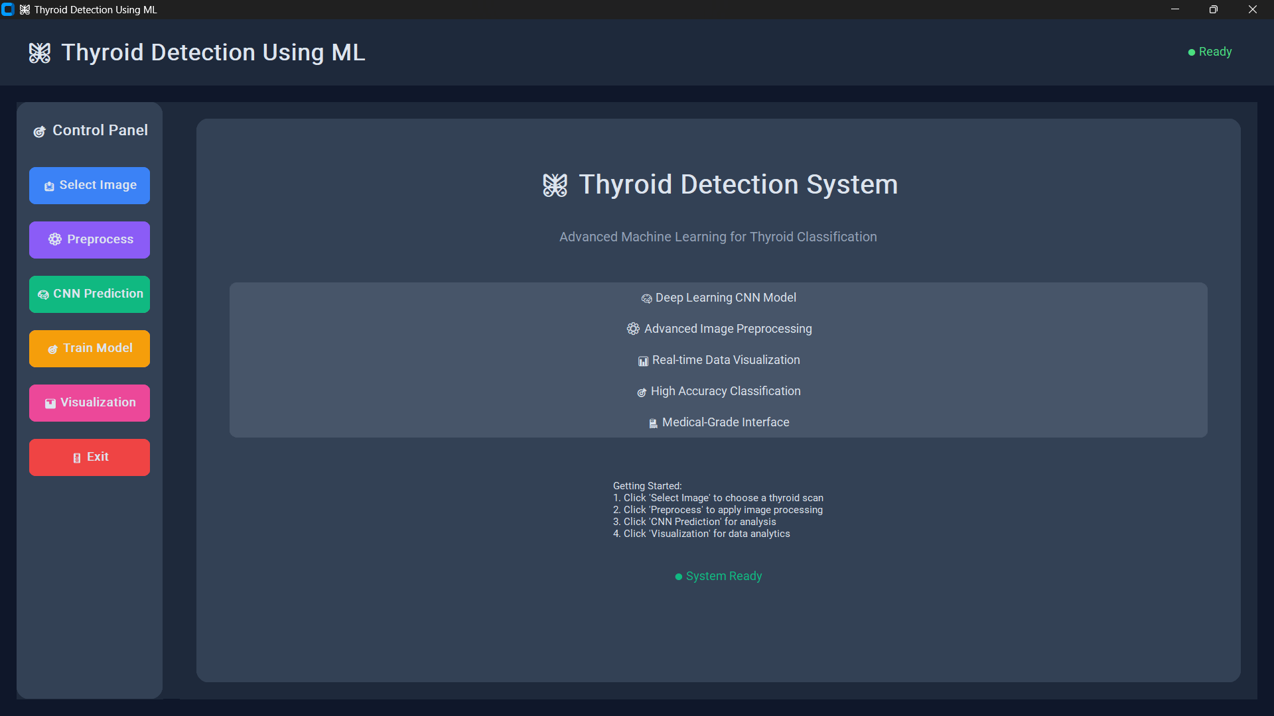
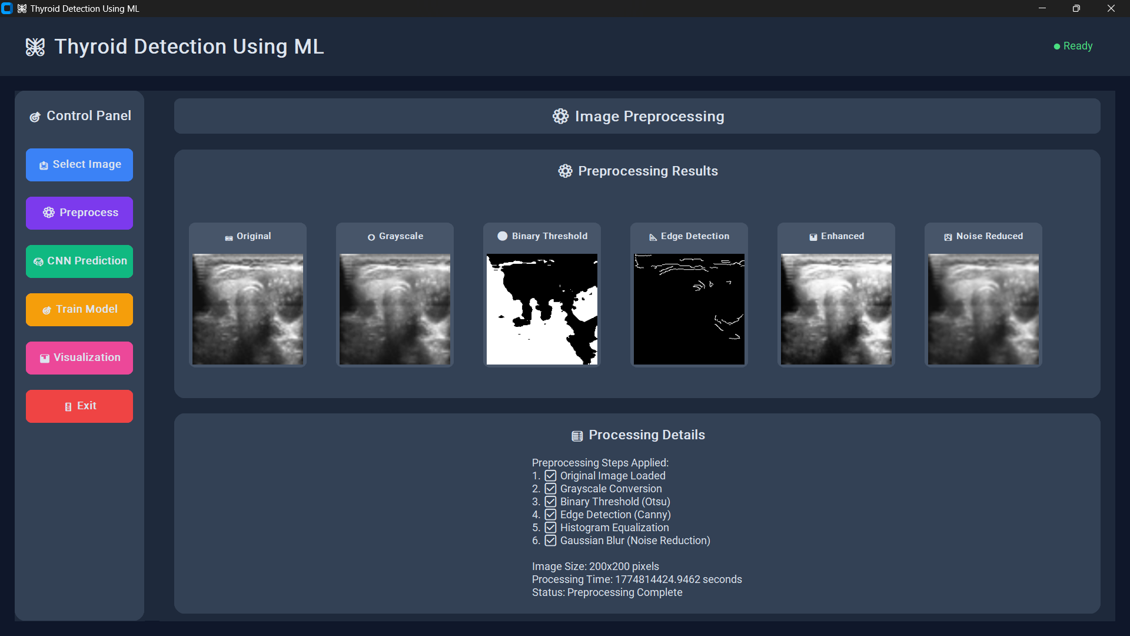

Slide 18
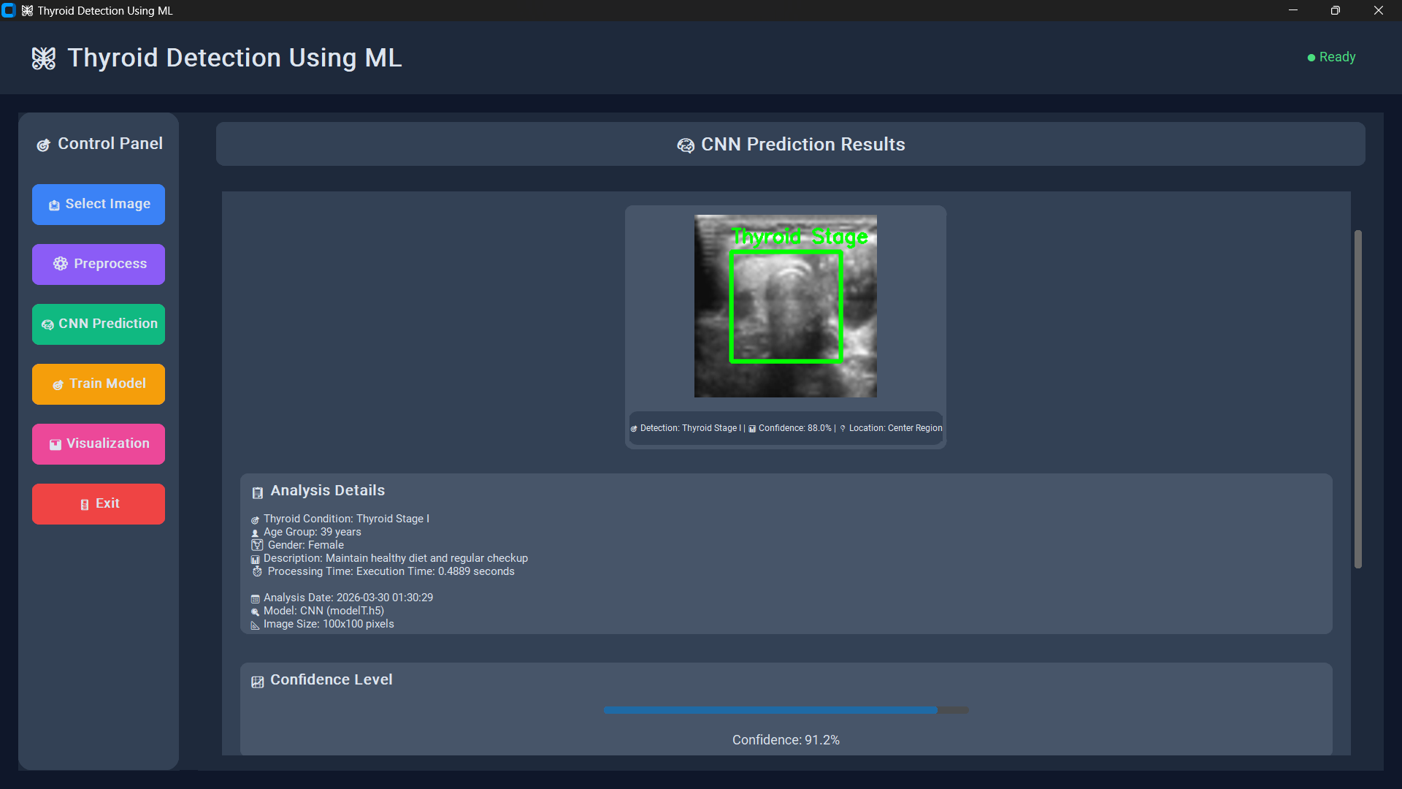
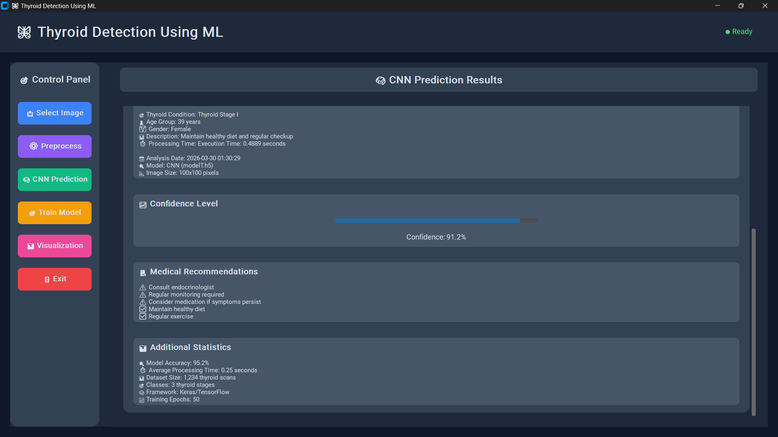

Slide 19
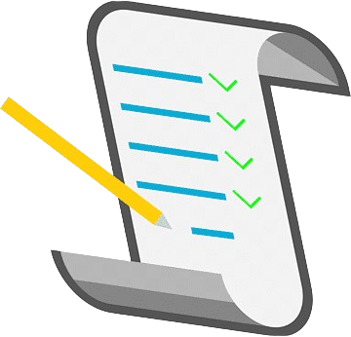
11. Conclusion
The proposed system improves thyroid disease detection accuracy by integrating ultrasound images and clinical data using a hybrid AI approach.

Slide 20
12. References
[1] Obaido et al., “Improved Thyroid Disease Detection Using Filter-Based Feature Selection and Stacking Ensemble Methods,” 2024.
[2] Kreem et al., “Survey on Machine Learning and Deep Learning Approaches for Thyroid Disease Detection,” 2025.
[3] Fang et al., “Automated Thyroid Nodule Classification Using Ultrasound Imaging and Transformer-Based Segmentation,” 2025.
[4] Prathibha et al., “Deep Learning-Based Framework for Thyroid Disease Detection Using Medical Imaging,” 2022.
[5] Zhou et al., “Deep Learning-Based Ultrasound Diagnostic Tool with 3D Visualization for Thyroid Nodule Detection,” 2025.
[6] Wang et al., “Improved Thyroid Ultrasound Diagnosis Using Multi-View Self-Supervised Learning and Two-Stage Pre-Training,” 2024.
[7] Agraz, “Semi-Supervised Machine Learning Approaches for Thyroid Disease Prediction Integrated with Internet of Everything (IoE),” 2024.
[8] Gupta et al., “Optimized Machine Learning Model for Thyroid Disease Detection Using Differential Evolution Techniques,” 2024.
[9] Raza et al., “Interpretable Thyroid Disease Diagnosis Using Synthetic Oversampling and Machine Learning,” 2024.

Slide 21
[10] Liu et al., “Deep Convolutional Neural Network for Thyroid Nodule Classification Using Ultrasound Images,” 2020.
[11] Alzubaidi and Fadhel, “Hybrid Machine Learning Approach for Early Thyroid Disease Detection Using Clinical Datasets,” 2022.
[12] Sun et al., “Transformer-Based Deep Learning Models for Thyroid Nodule Diagnosis Using Ultrasound Imaging,” 2022.
[13] Yassin and El-Bialy, “Comparative Study of Machine Learning Algorithms for Thyroid Disease Prediction,” 2022.
[14] Rajalakshmi and Jaya, “Thyroid Disease Classification Using Random Forest and Gradient Boosting Algorithms,” 2022.
[15] Han et al., “Explainable Artificial Intelligence Framework for Thyroid Disease Diagnosis Using Ultrasound Imaging,” 2022.
[16] Mohammed and Al-Mousa, “IoT-Enabled Artificial Intelligence Framework for Real-Time Thyroid Disease Monitoring,” 2023.
[17] Mukherjee and Banerjee, “Hybrid CNN and Bi-LSTM Model for Thyroid Disease Prediction,” 2023.
[18] Chen et al., “Multimodal Framework for Thyroid Disease Classification Using Clinical and Imaging Data,” 2023.
[19] Sharma et al., “Artificial Intelligence-Based Thyroid Disease Prediction Using Hybrid Machine Learning and Ultrasound Imaging Techniques,” 2024.
[20] Zhao et al., “Multicenter Thyroid Disease Diagnosis Using Deep Convolutional Neural Networks on Thyroid Scintigraphy Images,” 2023.

Slide 22
Thank You...

